Slide 1
Better Conversations for
Better Informed Consent
Gretchen Schwarze, MD, MPP, FACS
Morgridge Endowed Professor of Vascular Surgery
University of Wisconsin-Madison
Department of Surgery, Department of Medical History and Bioethics

Slide 2
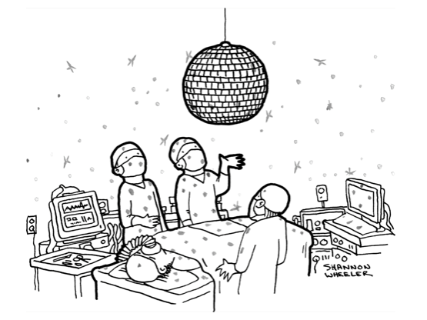
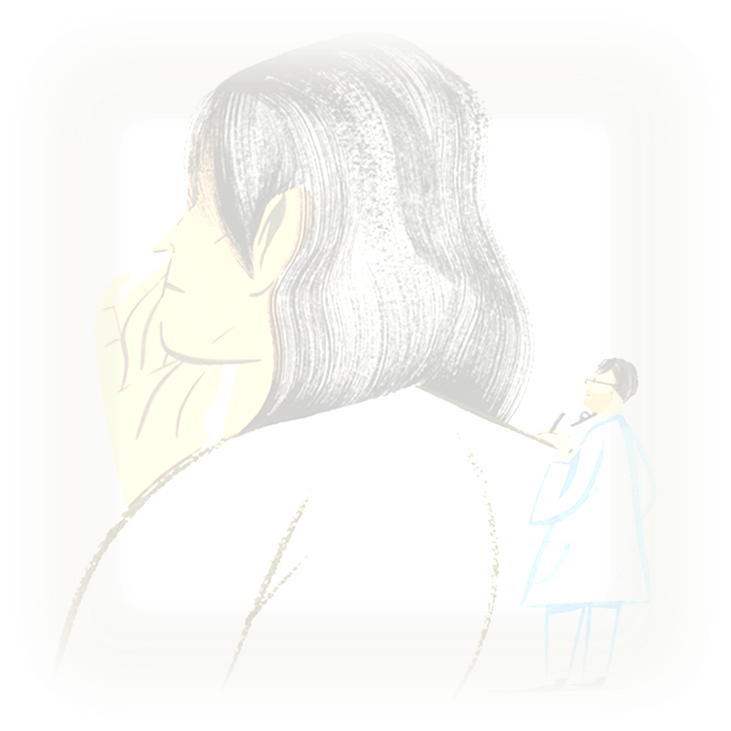
DISCLOSURES:
Current Funding for Research
NIH: R01AG065365
NIH: R01AG078242
NIH: K24AG073476
Other
Mezlight LLC
Notes:
Not just for surgeons, but for all clinicians, because we all need to collaborate with patients and families about how best to take care of them.

Slide 3
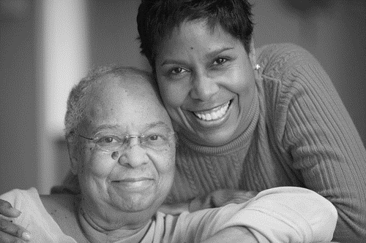

Slide 4
“This is your problem and this is the operation I have to fix it”
Notes:
Over the past 10 years in my lab, we have recorded more than 500 conversations between surgeons and patients.
Surgeons start with an explanation…
We talk about the disease – we show films, cat scans, etc.
We say this is your liver and here is a big tumor in it, and I can take it out.
We say, this is your problem, and this is the operation I have to fix it.
Even though we go on to talk about whether we should do that – perhaps the problem is too broken to fix, or not broken enough, or there are risks, and you won’t be the same after surgery.
We spend a ton of time describing how and we rarely explain why.

Slide 5
Education about Stage and Grade
as far as esophageal cancer, or most cancer, these stages one to four, four being the most advanced and one being the earliest. But really for esophageal cancer there is stage 1A 1B, 2A 2B, 3A 3B, 3A 3B 3C, 4A and 4B… [snores], makes your head explode, right?! It’s kind of confusing, so I boil it down to basically three main groups. The first one is early stage, [writing on paper, as if to show her a diagram], an intermediate stage… [still writing], and then advanced stage. So going back to our picture here, early stage is when it’s confined to just the esophagus, hasn’t burrowed very deep, is very superficial… chances of it being in the lymph nodes are extremely low, hasn’t spread to other areas. That’s early stage. Intermediate stage is typically when, and that’s the stage we see most patients, because… these don’t start causing problems, difficulty swallowing, things like that, until it gets to that intermediate stage. Um, and that’s where it’s in the esophagus, and it’s burrowed through some of the layers of the esophageal wall, and it’s gotten in to the lymph nodes.
I want to tell you about two terms that we use to describe cancer so you are familiar with because those are sometimes confusing. One is called- grade. A grade is how the cells looks like under the microscope. So there is grade one, two, and three, and [inaudible 10:12] and high grade and so on and so forth. So you have high grade cancer. Meaning, an aggressive type of cells. ‘Cause grade describes cells. And you have high grade, meaning high aggressive cells. The stage sounds very sif- similar to grade but it’s, it’s des- it’s um used in different manner. Stage, it describes where the cancer have traveled to. So we have stage one, two, three, and four. Stage one is when the cancer is limited to its organ. Here, it’s the uterus. Stage two is when the cancer in the uterus have gone to the cervix. Stage three is when the cancer of the uterus have gone to the tubes, to the ovaries, to the lymph nodes. And stage four is beyond. We don’t know what your stage is. We don’t know
So we give a grade to uh, prostate cancer, and it’s like different from any other cancers. We give it what’s called a Gleason score. Gleason’s just uh, the guy’s name. So they run fr—you know, theoretically it can run from 1 to 10, but I’ve never seen anything less than 5. It’s given by pathologists. They look at it and they, by the way how it looks under the microscope they decide whether it’s going to be a number. So the lowest I’ve seen 5, the highest I’ve seen 10. 10’s obviously really bad. 5 is probably the better variety. So yours came back a 6. Which is, which is a good variety. Um, and lately somebody with 6 a lot of times we watch these people. We don’t even treat them. We just watch them. However in your particular case, there was a lot of cancer. It wasn’t in, in one or two spots. As a matter of fact it was in uh, in a number of spots. Uh, one, two, three, you know, so there was um, you know, there’s some, um, you know, a little bit more than just a little bit. So even though it’s 6, I would still, here, we come back a total of 6 out of 12, uh pieces

Slide 6
Anatomy Class
Now, the esophagus is a muscular tube, it’s made up of multiple layers, inside layer is the mucosa, like the inside of your mouth. Patient: Mhm. Surgeon: Next layer is submucosa then there are two muscle layers, one running… circular muscle fibers that run around the esophagus and then there’s longitudinal ones that go up and down. There’s two layers of muscle, and then outside of that is some surrounding fat in the lymph nodes. These cancers, they tend to happen, start on the inside, of the mucosa. And then they get bigger and they grow deeper through the wall of the esophagus. And if they get to a certain depth, then there is a possibility that the cancer cells can spread through the lymphatic channels that connect the lymph nodes- Patient: Mhm. Surgeon: Go to the lymph nodes, and then can go to other places in the body. Ok? So that’s just the basic anatomy of things.
so one artery in the neck, this artery [inaudible 1:18] on the right side. Here’s the skull. One enters the skull, with these small branches and uh, after a while it makes a big bifurcation, and, this artery is main artery, supply blood all the spots in the brain, and they call it middle cerebral artery…and we call it MCA, we abbreviate it MCA and this is second most common location for the brain aneurysms. And you have aneurysm like this. It’s around four, five millimeters. Uh, it’s uh, size-wise it’s right at the border, to be concerning, but what has, has a little daughter sac, or daughter tit, we call it Murphy’s tit, and it looks like it’s ready to rupture. So when we see that kind of feature, the sizes are borderline, that justifies for the treatment, because once you burst an aneurysm… there’s a fifty percent chance you’ll die at the spot, can’t even make it to the hospital.

Slide 7
How I Do It
Um, and then you cut it off urethra, you, that, that’s when the prostate’s completely out. You take the bladder neck and urethra and you put it back together. And then you do a continuous suture to put it back together.
And at the end of it, it results in that the tumor in the lower part of your esophagus and two thirds of your esophagus and one third of your stomach being removed, alright? Now we have to take those wide margins out of there because this cancer has, it kind of has a habit of being able to grow up the esophagus very rapidly. Well, not just from the point where you find it, but also infiltrates up there to those layers of the esophagus, very high as well. And they can do the same thing down into the stomach, so that’s why we have to have these margins, are fairly long, alright? But, practically what that looks like, as I have shown before, is the fact that if you have an esophagus, and a stomach, that’s right there it goes through the hiatus here, your chest cavity that’s your abdominal cavity, if you have your tumor right there, which is where it was, alright, and then through that tumor you had…there’s a stent, alright? That’s what I’m stenting open. But now that the stent is gone, to take this tumor out, alright, there’s your collarbones coming together right there, we have to take the esophagus from about here, and take a third of the stomach right here, and remove all of this. Okay? Then that’s essentially removing the cancer and any possible tissues involved as well. Now that only leaves you with an open esophagus and it leaves you with a stomach like this, and we bring the both of them together, we actually bring that stomach up through the hole that’s left, through the hiatus, bring it all the way up and through an incision in your neck we put it together. [drawing] Put it together with your esophagus. And it will lie in a position probably just right about right here. So that is called a gastric pull-up. And that’s the way we reconnect you again, to make up the distance that-
Okay? Now they’re pointing at this other small area that is also within the middle lobe that’s not, in my opinion, entirely convincing of being a separate area of tumor, um, we, we see a lot of things that look sort of like that. Like a lymph node in transit and some other things. Um, and, surgically we like to look at this in a whole bunch of ways but we can, we can see that, that margin here, between the upper lobe and the middle lobe, this, this tumor is kind of up against the fissure, um, but it’s in an area where that fissure is usually more separate, so I think that, that the tumor could be resected, or taken out with a what’s called a right middle lobectomy. And… whenever we, look at… folks who have some emphysema and we talk about, taking part of the lung out, we always have to think about it. Right?

Slide 8
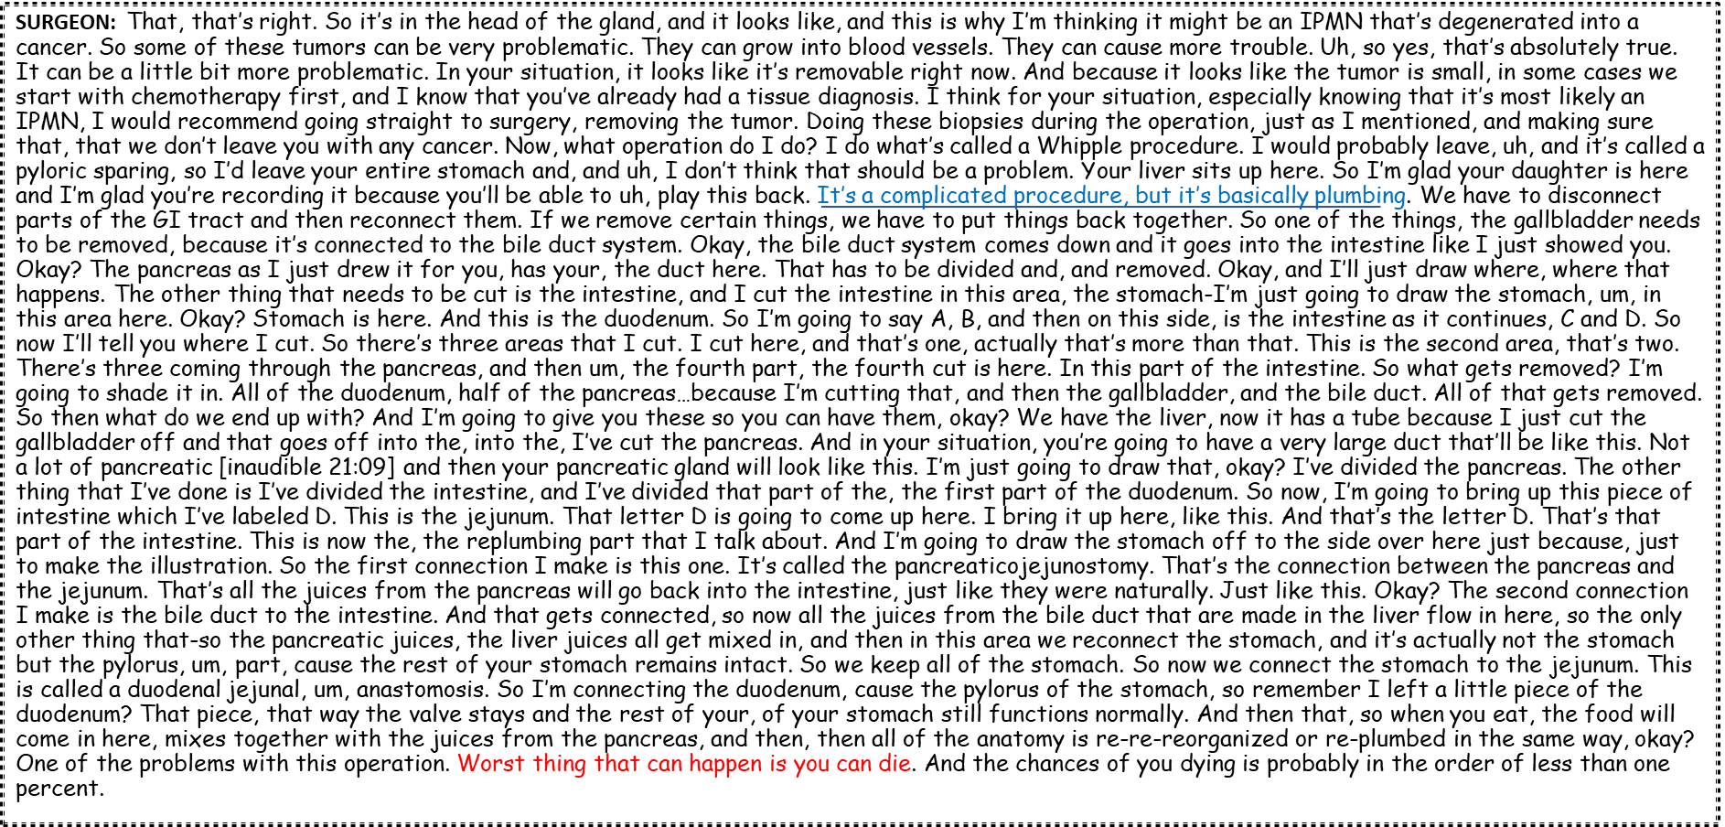
Descriptions of Procedures
Notes:
This is un-edited data from my lab--a surgeon working really hard to very brilliantly describe a Whipple.
And to be clear, this is typical. We all do this.
But it’s not so clear to me that this is the kind of information that a) patients can absorb, or b) it will help them make a decision.
Rather than telling people what we are going to do in the operating room, we need to tell them what we are hoping to achieve if we operate.

Slide 9
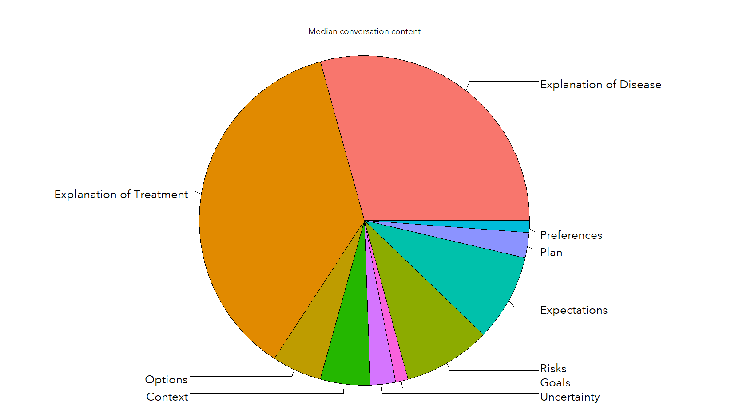
Explanation of Disease and Explanation of Treatment Consumes the Decision-Making Conversation
Stalter L, et. al, MDM, April 2023

Slide 10
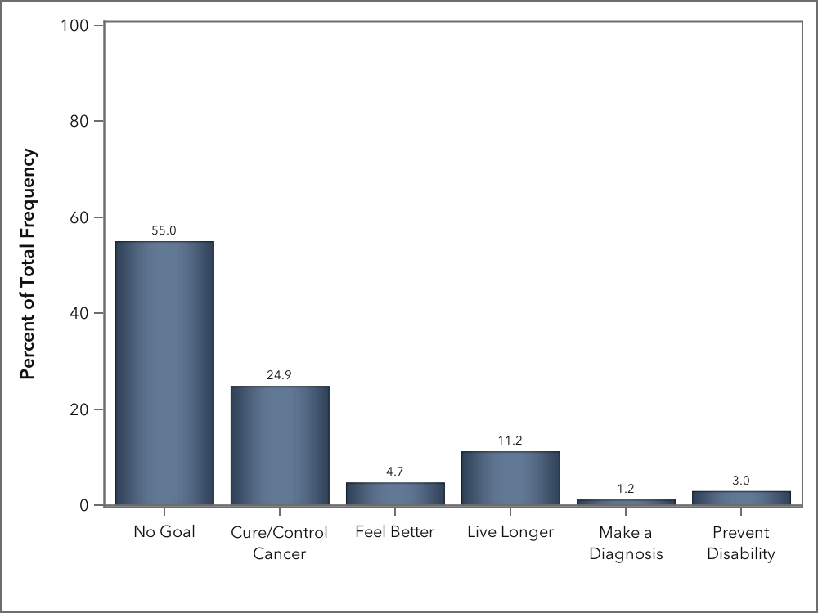
In >75% of conversations no goal or cure/control cancer was the only goal mentioned
Stalter L, et. al, MDM, April 2023

Slide 11
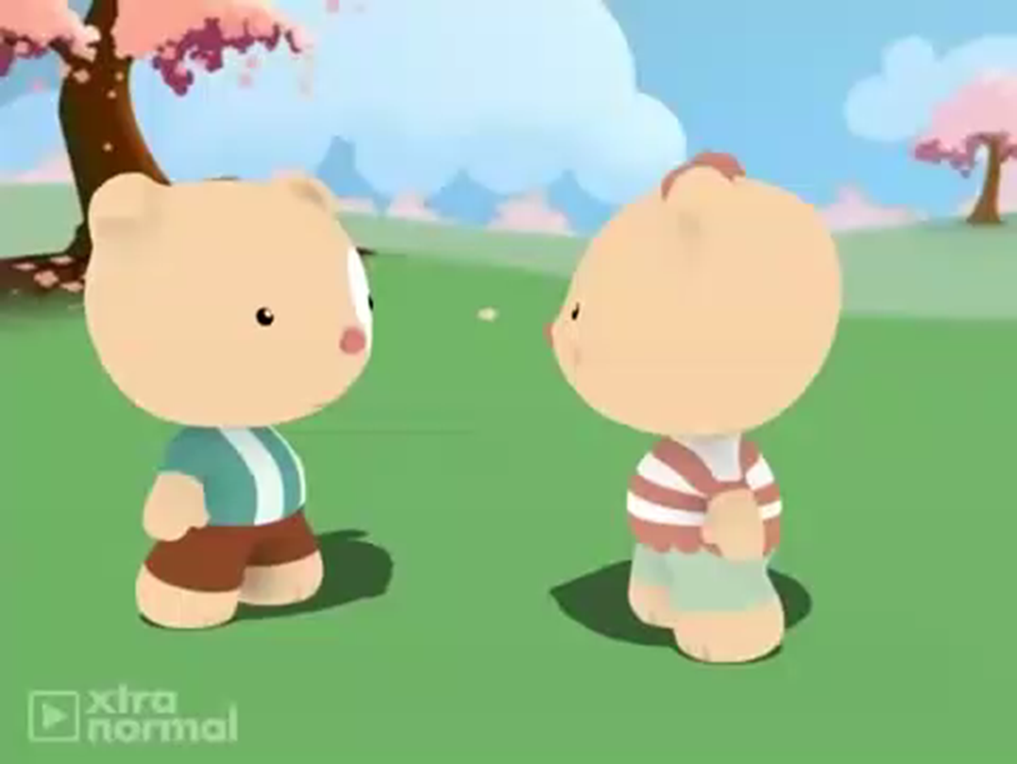
In 89% of conversations “fix-it” was used to describe treatment
Notes:
I will often start an operation by asking the medical student or the resident, “Why are we doing this case?”
And invariably they will say, “There’s a blockage” or “This aneurysm meets criteria.”
I keep asking but it often takes a long time to get to “prevent limb loss” or “to make her feel better.”
Somehow, we have internalized this notion of fixing to the point where we have forgotten about the person attached to it.

Slide 12
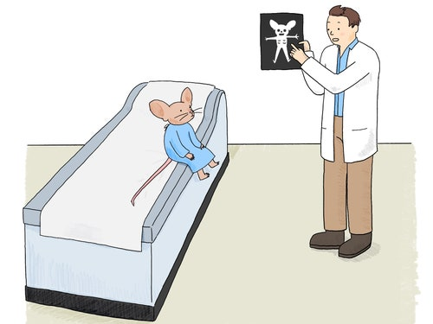
The New Yorker
Daily Shouts
If You Give a Mouse a Routine Checkup
You might discover that he needs a minor surgical procedure.
By Ellie Black

Slide 13
Surgeons offer “Non-choice choices”

Slide 14
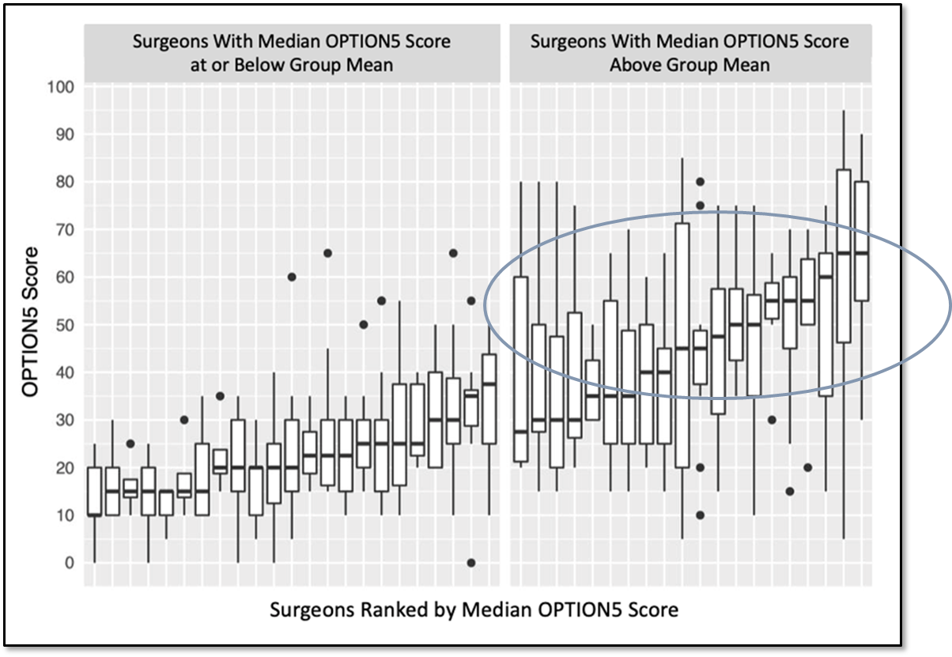
Baggett N, et. al, JAMA Surgery, February 2022
“Telling clinicians to ‘offer patients more choice’ may not achieve its objective.”
Torien M., et. al, “Offering Choices…”Epilepsy Behavior, 2021

Slide 15
CORE FRAMEWORK for INFORMED CONSENT
Patient understanding
of disease and treatment
Risks
Reportable complications
Permission to proceed
Bleeding
Infection
Heart attack
Stroke
Death
Alternatives
Non-choice choices
Explanation
of disease
Explanation
of treatment
Benefit = The problem will be fixed

Slide 16
BETTER CONVERSATIONS for SURGERY
BETTER CONVERSATIONS for SURGERY
Downsides
Bad things that happen to everyone
Bad things that could happen
Surgery falls short
Goal(s) of surgery
Downsides
Bad things that happen to everyone
Bad things that could happen
Surgery falls short
Deliberate
Between goals and downsides
Goal(s) of surgery
Deliberate
Between goals and downsides
Show your cards
Where the surgeon is
starting from
Live longer
Feel better
Prevent disability
Make a diagnosis
Show your cards
Where the surgeon is
starting from
Live longer
Feel better
Prevent a disability
Make a diagnosis
Agreement & A Plan
Agreement & A Plan
Don’t reach our goals
Don’t reach our goals

Slide 17
PROLOGUE
Gather
Info
I looked thru your records…
I want to make sure we are on the same page
Dr. X sent you because….
I heard you have X, I’d like to gather a bit of information and then see how best to help you….

Slide 18
BETTER CONVERSATIONS for SURGERY
BETTER CONVERSATIONS for SURGERY
Downsides
Bad things that happen to everyone
Bad things that could happen
Surgery falls short
Goal(s) of surgery
Downsides
Bad things that happen to everyone
Bad things that could happen
Surgery falls short
Deliberate
Between goals and downsides
Goal(s) of surgery
Deliberate
Between goals and downsides
Show your cards
Where the surgeon is
starting from
Live longer
Feel better
Prevent disability
Make a diagnosis
Show your cards
Where the surgeon is
starting from
Live longer
Feel better
Prevent a disability
Make a diagnosis
Agreement & A Plan
Agreement & A Plan
Don’t reach our goals
Don’t reach our goals

Slide 19
Show Your Cards
Emergency
waiver of consent
Would not offer surgery
Definitely would DO this Surgery
Definitely would NOT DO this Surgery
True Equipoise

Slide 20
Show Your Cards
Usually, we think about doing surgery for this
I think surgery might help you…
Emergency
waiver of consent
●Authorization
●Anticipation
Would not offer surgery
● Agree to disagree
● Agree to disagree
Definitely would DO this Surgery
Definitely would NOT DO this Surgery
True Equipoise

Slide 21
Show Your Cards
We don’t usually operate in this setting..
I am worried surgery is not a good idea
Emergency
waiver of consent
●Authorization
●Anticipation
● Confirmation
Would not offer surgery
● Agree to disagree
● Agree to disagree
Definitely would DO this Surgery
Definitely would NOT DO this Surgery
True Equipoise

Slide 22
Show Your Cards
I’m on the fence
There are 2 ways to treat this
Emergency
waiver of consent
●Authorization
●Anticipation
Decision Making
● Confirmation
Would not offer surgery
● Agree to disagree
● Agree to disagree
Definitely would DO this Surgery
Definitely would NOT DO this Surgery
True Equipoise

Slide 23
Show Your Cards
I’m on the fence
There are 2 ways to treat this
We don’t usually operate in this setting..
I am worried surgery is not a good idea
Usually, we think about doing surgery for this
Emergency
waiver of consent
●Authorization
●Anticipation
Decision Making
● Confirmation
Would not offer surgery
● Agree to disagree
● Agree to disagree
Definitely would DO this Surgery
Definitely would NOT DO this Surgery
True Equipoise

Slide 24
BETTER CONVERSATIONS for SURGERY
BETTER CONVERSATIONS for SURGERY
Downsides
Bad things that happen to everyone
Bad things that could happen
Surgery falls short
Goal(s) of surgery
Downsides
Bad things that happen to everyone
Bad things that could happen
Surgery falls short
Deliberate
Between goals and downsides
Goal(s) of surgery
Deliberate
Between goals and downsides
Show your cards
Where the surgeon is
starting from
Live longer
Feel better
Prevent disability
Make a diagnosis
Show your cards
Where the surgeon is
starting from
Live longer
Feel better
Prevent a disability
Make a diagnosis
Agreement & A Plan
Agreement & A Plan
Don’t reach our goals
Don’t reach our goals

Slide 25
The 4 Goals of Surgery
Help people:
Live longer
Feel better/improve function
Preserve function/prevent a disability
Make a diagnosis
Specify the goal:
How much longer?
How much better?
What disability?

Slide 26
“We usually do surgery for this . . .”
“Our goal is to . . .”
or
“The reason to consider surgery is…”
May need to dispel false beliefs
Surgery will not … (make you pain free, stop the ringing in you ears, improve your erectile dysfunction…)

Slide 27
BETTER CONVERSATIONS for SURGERY
BETTER CONVERSATIONS for SURGERY
Downsides
Bad things that happen to everyone
Bad things that could happen
Surgery falls short
Goal(s) of surgery
Downsides
Bad things that happen to everyone
Bad things that could happen
Surgery falls short
Deliberate
Between goals and downsides
Goal(s) of surgery
Deliberate
Between goals and downsides
Show your cards
Where the surgeon is
starting from
Live longer
Feel better
Prevent disability
Make a diagnosis
Show your cards
Where the surgeon is
starting from
Live longer
Feel better
Prevent a disability
Make a diagnosis
Agreement & A Plan
Agreement & A Plan
Don’t reach our goals
Don’t reach our goals

Slide 28
The bin of bad s@#! has 3 layers
1. Expected stuff
2. Possible bad stuff
3. We fall short

Slide 29
The Downsides of Surgery
Expected stuff
Surgery and recovery
2. Possible unpleasant & really bad stuff
Bumps in the road:
Major changes:
Complications:
Unexpected stuff:
3. Surgery falls short
We don’t meet the goals

Slide 30
BETTER CONVERSATIONS for SURGERY
BETTER CONVERSATIONS for SURGERY
Downsides
Bad things that happen to everyone
Bad things that could happen
Surgery falls short
Goal(s) of surgery
Downsides
Bad things that happen to everyone
Bad things that could happen
Surgery falls short
Deliberate
Between goals and downsides
Goal(s) of surgery
Deliberate
Between goals and downsides
Show your cards
Where the surgeon is
starting from
Live longer
Feel better
Prevent disability
Make a diagnosis
Show your cards
Where the surgeon is
starting from
Live longer
Feel better
Prevent a disability
Make a diagnosis
Agreement & A Plan
Agreement & A Plan
Don’t reach our goals
Don’t reach our goals

Slide 31
Generate a deliberative space
goals of surgery v. the downsides
How are you thinking about this?
How much does it bother you?
How much are you willing to go through?
Is it worth it?

Slide 32
CONTEXT
GOALS
DOWNSIDES
DELIBERATE
Schwarze ML, et. al, “Innovations in Surgical Communication 1-4,” JAMA Surgery, October 2023

Slide 33
Live longer
Feel better
Prevent a disability
Make a diagnosis
CONTEXT
GOALS
DOWNSIDES
DELIBERATE
Schwarze ML, et. al, “Innovations in Surgical Communication 1-4,” JAMA Surgery, October, 2023

Slide 34
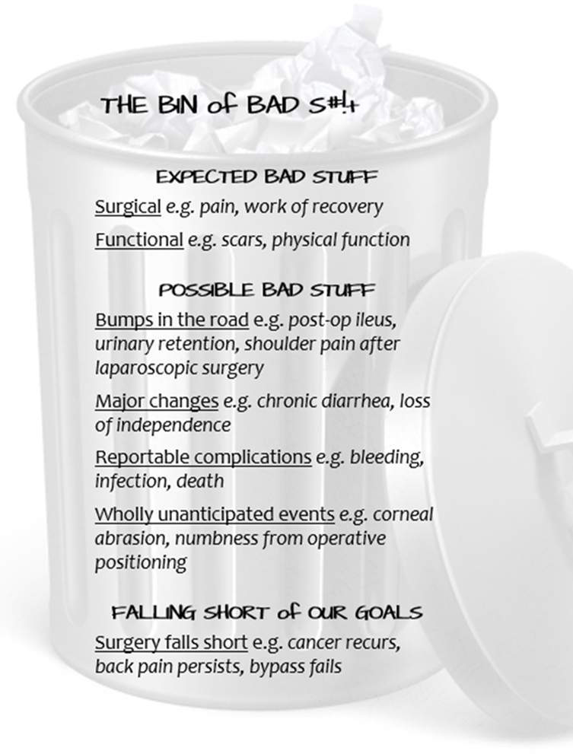
CONTEXT
GOALS
DOWNSIDES
DELIBERATE
Schwarze ML, et. al, “Innovations in Surgical Communication 1-4,” JAMA Surgery, October, 2023

Slide 35
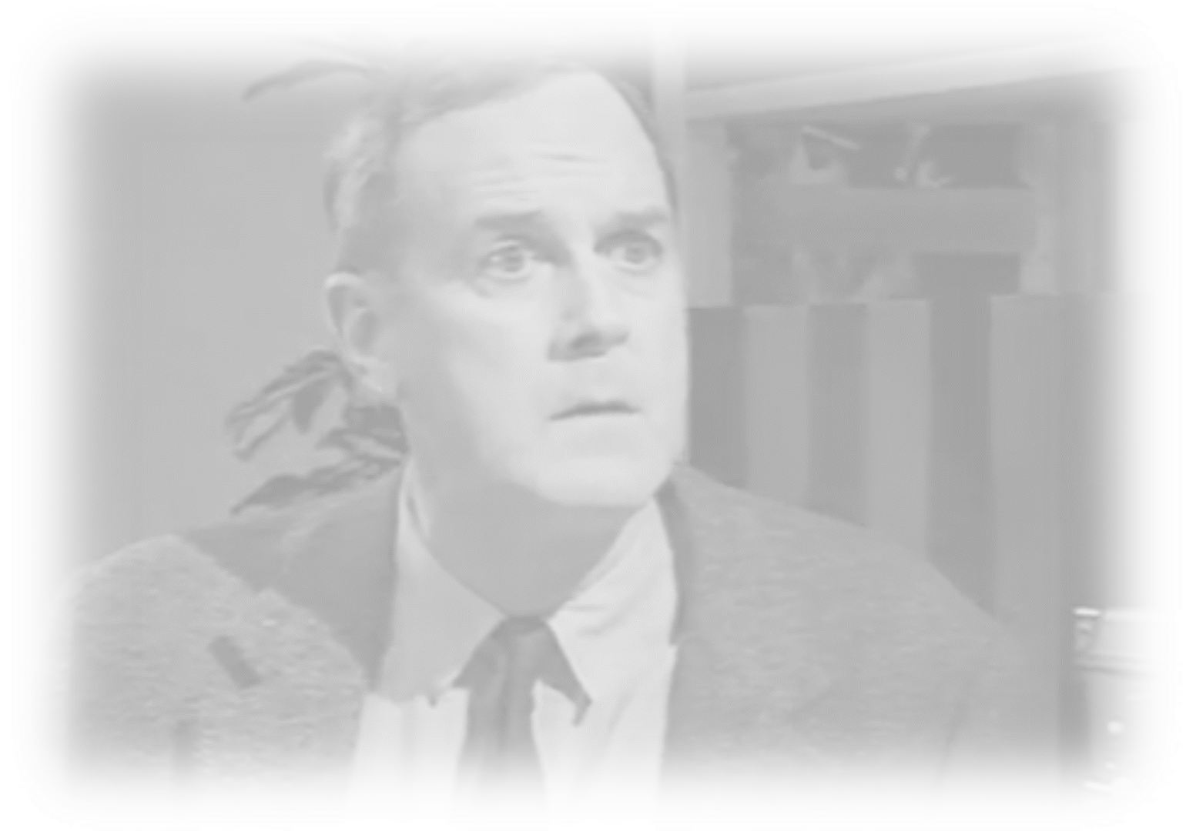
Better Conversations Every Surgeon, Every Patient, Every Time

Slide 36
“Do the best you can until you know better. Then when you know better, do better.”
Maya Angelou

Slide 37
Attend to emotion
Notes:
This is one more thing I struggle with the bioethicists about – that somehow these decisions are entirely rational and devoid of emotion.
At the end of the day, whether you are in the ICU with a dying patient or in clinic with a patient considering hernia surgery, we cannot escape the emotion. At the very least, the idea of having a surgical problem and surgery is scary.
In order to have a conversation about whether to have surgery, we need to attend to emotion first. And yet we show up to these conversations in a cognitive frame – focusing on information without recognizing the need to address emotion first.

Slide 38
N
U
R
S
E
- naming
- understanding
- respecting
- supporting
- exploring
Notes:
Our colleagues in palliative care have some very straightforward skills we can borrow – This NURSE mnemonic is a great way to stay out of that cognitive rabbit hole.
N – name the emotion – “this is really sad”
U – understand – “I can see how this would come as a surprise”
R – respecting – use a praise statement here – “you are such a good advocate for your mother”
S – supporting “I’m here to take care of your mother,” and
E – exploring “tell me what you mean when you say ‘she’s a fighter’”
So, when you get called to the ICU to see a dying patient with biliary sepsis or a perforated viscous and the patient’s daughter is in tears, screaming about “how her mother was fine yesterday” and “how did this happen…” it’s not the time for a lecture on biliary stasis or a discussion of seeds and outpouchings in the muscularis mucosa. The answer to “why did this happen” is “this is really sad…clearly you love your mother so much…”

Slide 39
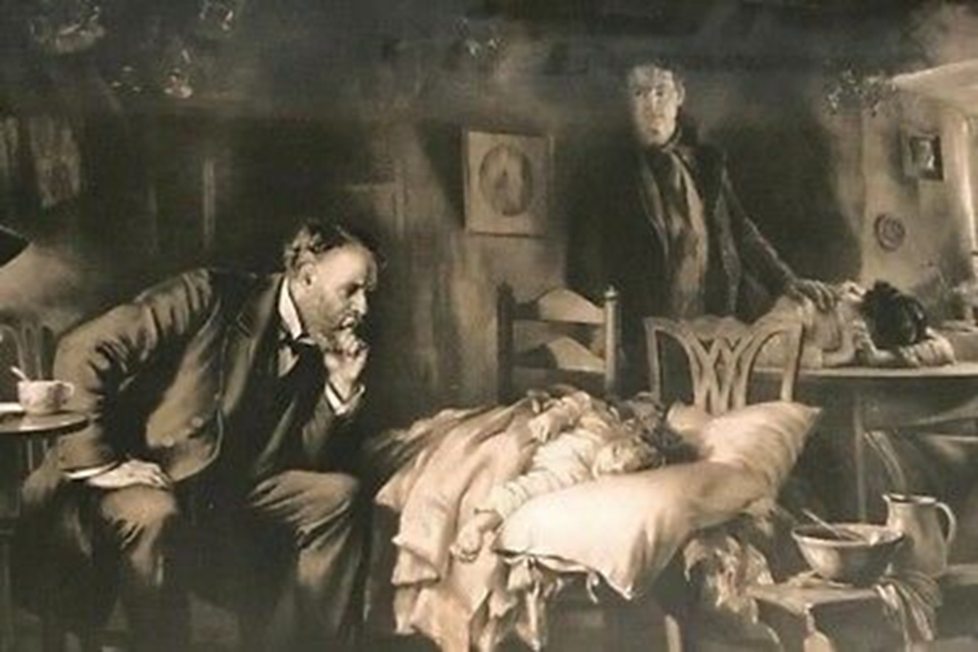
I wish….
Notes:
Finally, patients and families will often say, “isn’t there anything else you can do”
Honestly, this is the worst question to ask a surgeon because I can always think of something else to do…
But the answer to the question “isn’t there anything else you can do” is not “I can do a 4th time re-do bypass below the knee with PTFE to a really shitty target!” Because that’s not going to meet anyone’s goals.
The answer to “isn’t there anything else you can do” is… “I wish.”

Slide 40
Thank you!
schwarze@surgery.wisc.edu
Additional Resources:
https://www.youtube.com/watch?v=FnS3K44sbu0
https://www.hipxchange.org/BCWC
https://www.patientpreferences.org
Bob Arnold
Justin Clapp
Jacky Kruser
Anne Buffington
Nate Baggett
Melanie Fritz
Bret Hanlon
Kyle Bushaw
Lily Stalter
Taylor Bradley

